Slide 1
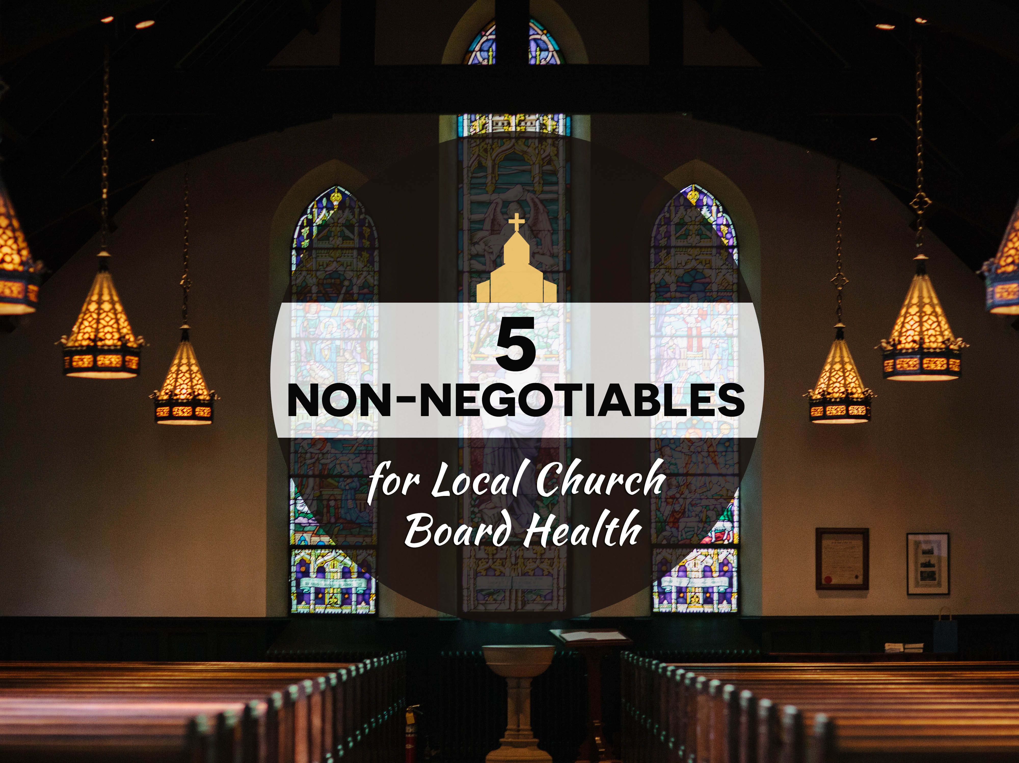
Five "Non-negotiables” for
Local Church Board Health

Slide 2

Strong boards empower missional and visionary leaders, and strong leaders embrace passionate and engaged boards.

Slide 3
Board development is
an on-going, intentional process;
not a one-time event.

Slide 4
The Manual defines the local church “Board” as the official decision-making leadership team of the church (para.127):
*elected from a nominating committee ballot
at an annual meeting of the church membership,
*no more than 25 members (including the pastor, and the
NMI, NYI and SDMI elected leaders),
*who are spiritually mature, and
*who are engaged in the mission and ministry of the local church.
(See also Manual paragraphs 107 – 160 for additional details)
The church board works with the pastor and represents the church membership in Board decision-making between annual meetings in:
*DEVELOPING MISSION AND MINISTRY STRATEGY,
*INSURING INTEGRITY IN BUSINESS AND LEGAL ISSUES,
*SHAPING POLICIES AND PROGRAMS FOR THE CHURCH,
*PRAYING FOR AND PLANNING WITH THE PASTOR.
*

Slide 5
We Believe in Boards…
Manual required.
Biblically supported.
Practically applied.
Ministry focused.
Mission driven.
We need Healthy Boards!

Slide 6
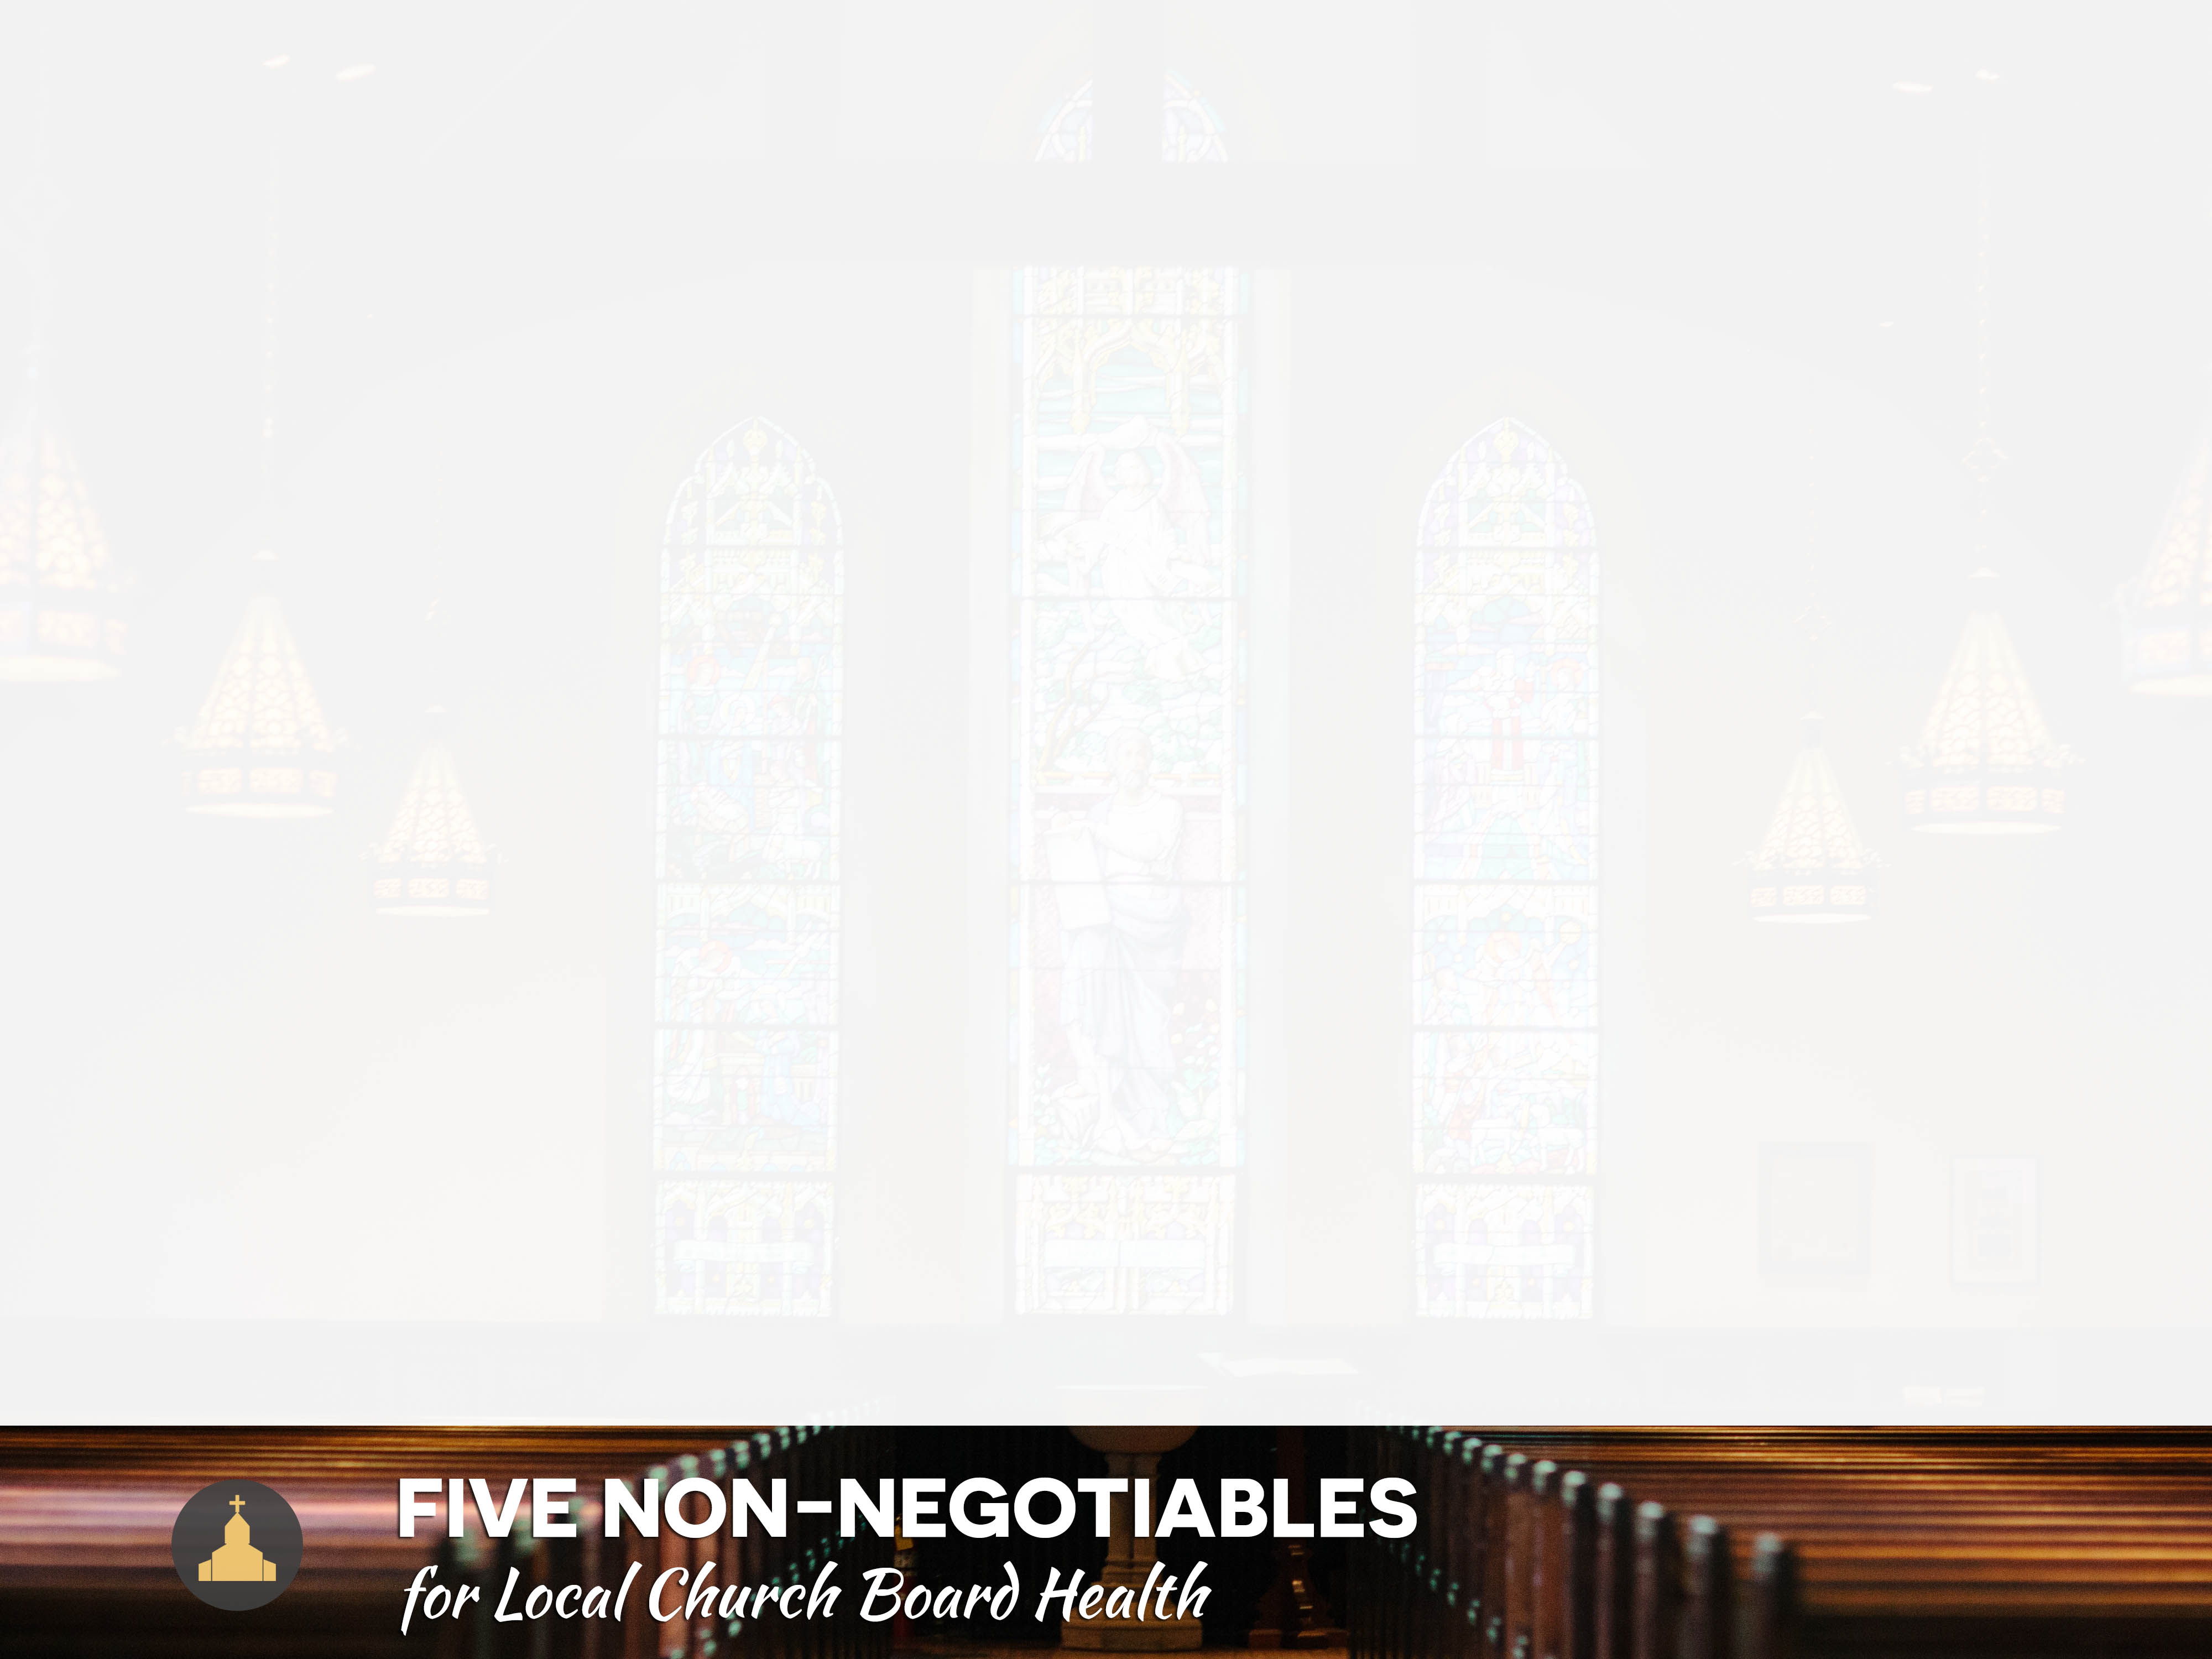
1. Know the Basics.
2. Ask the ‘Right’ questions.
3. Communicate in conflict situations with civility.
4. Embrace assessment and development in planning.
5. Nurture emerging leaders for the church board.

Slide 7

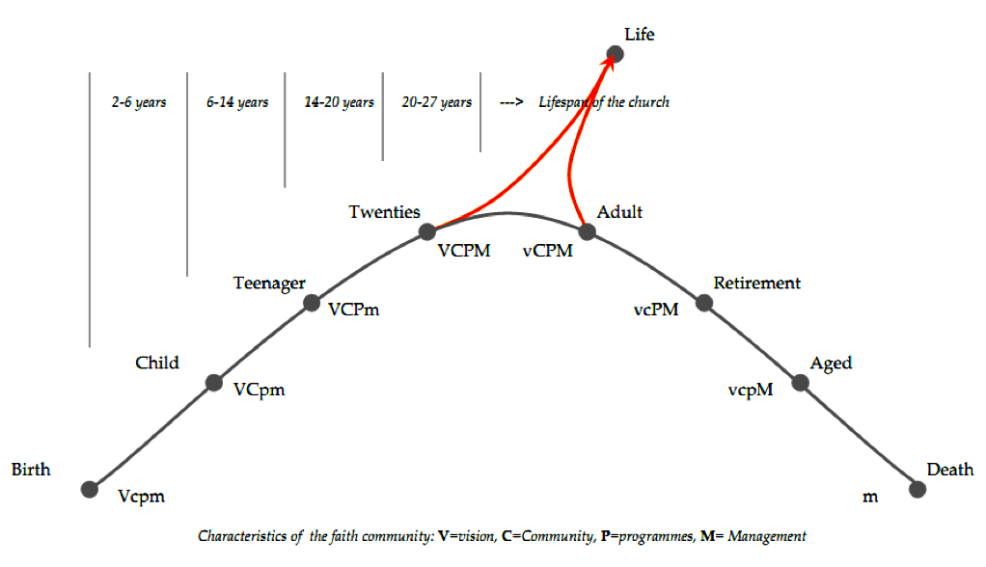
Lifespan and Stages of a faith community
New Life

Slide 8

Organizations evolve and change. So must their governing boards.

Slide 9
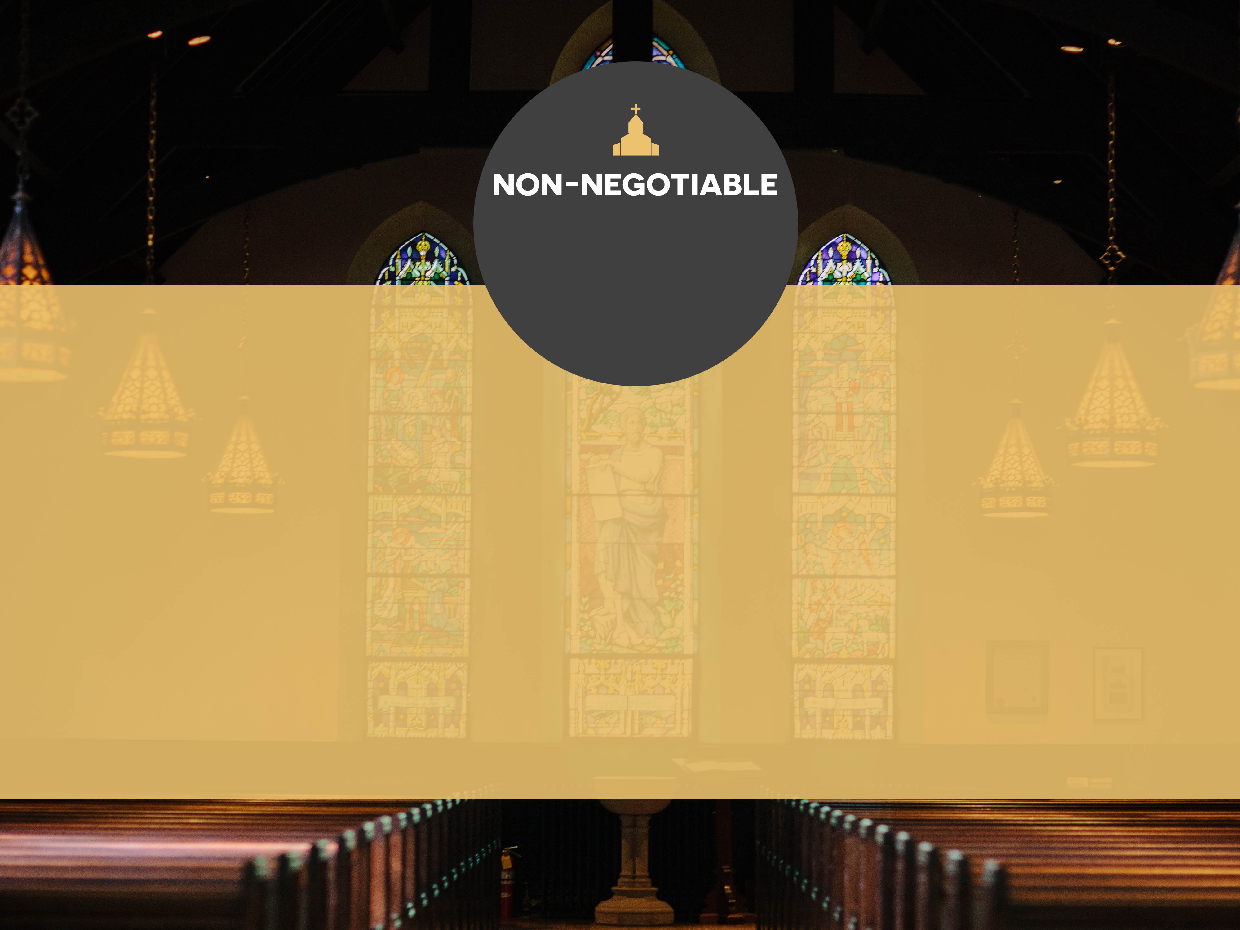
1
KNOW THE BASICS:
UNDERSTAND THE ESSENTIALS OF THE
BOARD’S ROLE, PURPOSE, AND FUNCTION
”HEADS IN; FINGERS OUT!”

Slide 10
Healthy Boards remember…
“HEADS IN – FINGERS OUT”
The board focuses on policy formulation
and mission strategy;
Not on daily operations
and personnel management.
Notes:
Board members are engaged in the oversight of the organization-questions, observing, commenting-but leave the operations and daily administration of the church or organization to the pastor/leader.
Effective boards empower and energize the elected leaders to do the work they were called to do.

Slide 11
An official local church board ...
Oversees the mission,
Develops a shared vision,
Shapes the future of the organization, and
Ensures Accountability...
to the government;
to church membership,
and for the leader(s).
Notes:
An elected body that oversees the ministry and mission of a local church between annual membership meetings.
The board is guided by the Church Manual Bylaws, Articles of Incorporation, and a Board Policy Handbook.

Slide 12
To Review: The Local Church Board...
*elected from a nominating committee ballot at an annual meeting
of the church membership,
*no more than 25 members (including the pastor, NMI, NYI and SDMI elected leaders),
*who are spiritually mature, and
*who are engaged in the mission and ministry of the local church.
(See also Manual paragraphs 107 – 160 for additional details)
  They may be elected as Trustees, for responsible for property and fundraising; as Stewards for responsible for church growth, evangelism; and as the Education Committee for Discipleship Training.
  Or, the Church Board may also be elected by the church membership as the Official Board, then organized into committees of the Board at the first meeting of the Board, for the purpose of:
*DEVELOPING MISSION AND MINISTRY STRATEGY,
*INSURING INTEGRITY IN BUSINESS AND LEGAL ISSUES,
*SHAPING POLICIES AND PROGRAMS FOR THE CHURCH,
*PRAYING FOR AND PLANNING WITH THE PASTOR.
Alternative board and committee structure may be used by a local church board in organizing itself for ministry and missional action….” See Manual para. 111.12

Slide 13
Four modes of thinking:
FIDUCIARY
STRATEGIC
REPRESENTATIVE
REFRAMING
Think of these modes of thinking as a continuous circle

Slide 14
FIDUCIARY MODE
Ensure legal and financial integrity
Steward of tangible assets
Approve and deploy resources missionally and wisely
Steward of long-term health and mission accomplishment of the church

Slide 15
STRATEGIC MODE
Planning partner with the pastor/leader
Proactive and intentional in strategic planning for mission and vision fulfillment
Reviews the strategic plan in light of the mission and vision of the church
Ensures that a strategic plan is in place

Slide 16
REPRESENTATIVE MODE
Comments are rooted in the church’s values, traditions, and beliefs
Questions are framed taking into account the heritage of the church
Concerns are expressed in terms of the consistency with the denominational policy and doctrines
Policies are developed and priorities are established consistent with the church’s mission, vision, and values

Slide 17
REFRAMING MODE
“Sees” the real question and the big picture
“Re-envisions” the situation
Articulates implications for the future
Serves as “problem-solver”
“Connects the dots”

Slide 18
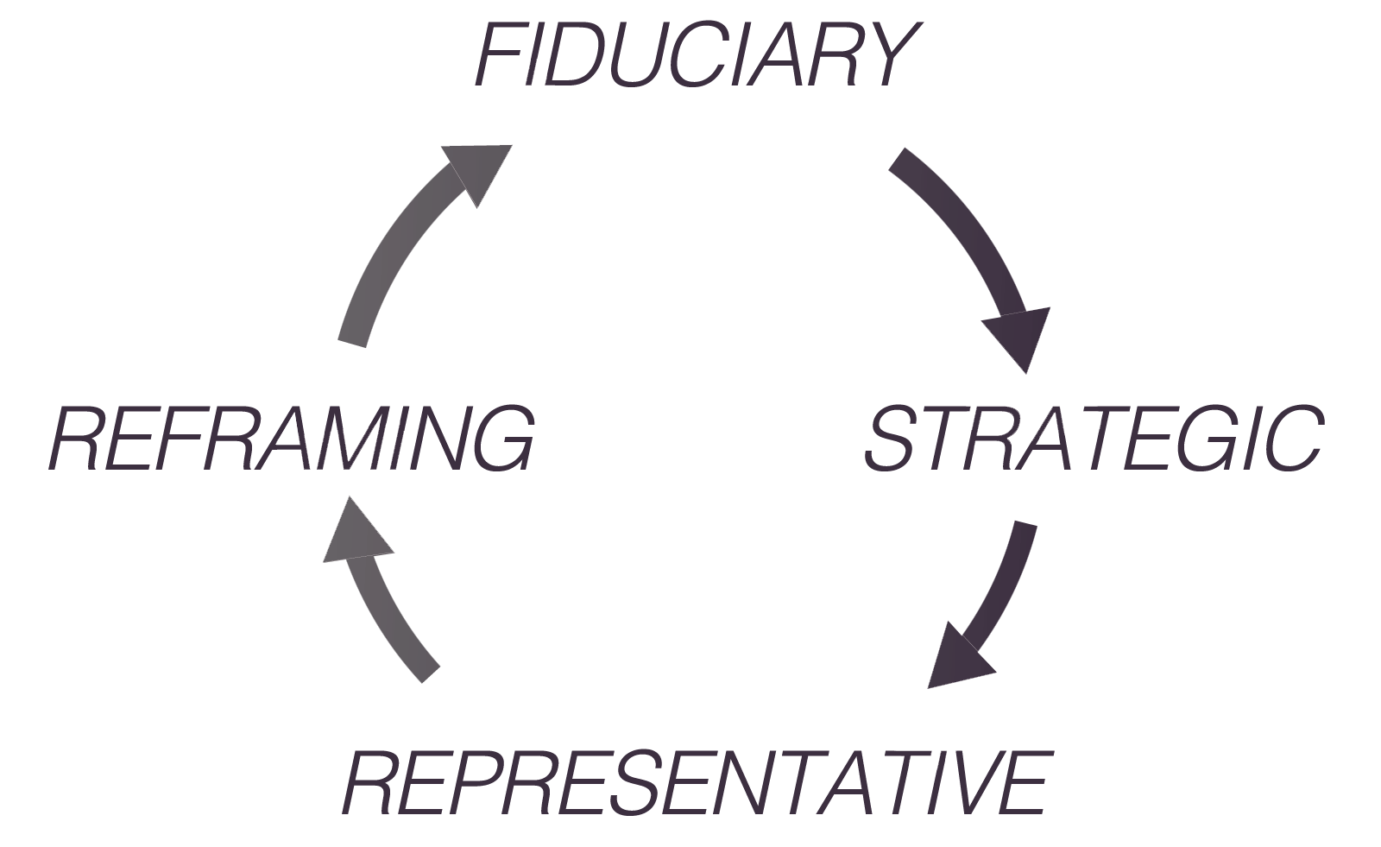
        Four Modes of Thinking about Governance

Slide 19
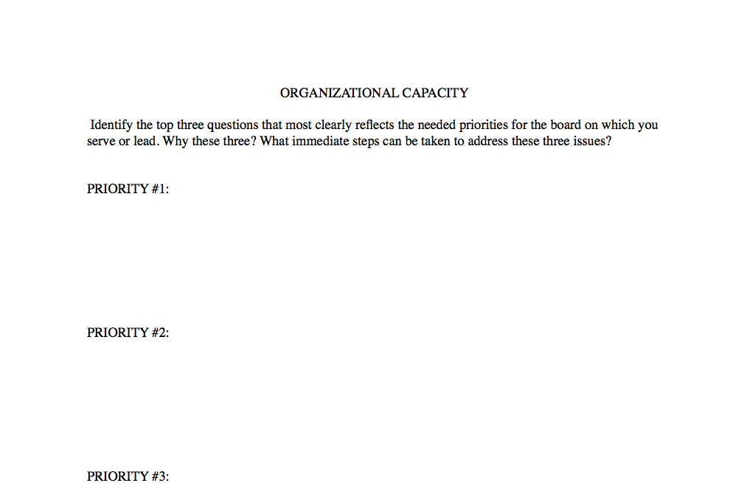
A Legal and Program REVIEW
See www.BoardServe.org. Click Blog. See February 24, 2015 blogpost.
See Leading Decisively! Leading Faithfully! Appendix D.

Slide 20
Church Board Survey
Please rate each statement as (1) strongly agree, (2) agree, (3) disagree, (4) strongly disagree.
A. Board and Mission:
B. Board/Pastor Relations:
C. Member to Member Relations:
D. The Board Agenda:
E. The Organization of the Board:
F. The Functioning of the Board:
G. Nuts and Bolts Issues
H. Summary
See Leading Decisively! Leading Faithfully! Appendix E.

Slide 21
To Review (again) Board Responsibilities
The board has fiduciary, strategic and representative governance and reframing responsibilities for the organization in at least the areas of:
        1. Mission and vision clarity
        2. Strategic thinking and planning
        3. Financial health, oversight and budget approval
        4. Major gifts and capital development
        5. Mission implementation, strategy and review
        6. Problem-framing or “sense-making”
        7. Organizational connectivity and networking
        8. Property oversight, expansion, and legal standing
Notes:
…helps interpret and sustain the church’s mission and goals with the pastor.…represents the interests and concerns of the congregation.…leads in selecting a pastor.
…is the bridge of accountability between the pastor and congregation....ensures the wise use of financial resources.…acts to ensure legal and moral responsibility.

Slide 22
A VISION STATEMENT for boards
“The leadership ministry of
our church board
enables the church attendees
to fulfill their ministry to each other
in the congregation, and their mission
in the neighborhood and beyond!”

Slide 23
2
ASK THE “RIGHT” QUESTIONS.
Nurture a culture of asking mission-driven
and sustainability QUESTIONS

Slide 24

Questions such as:
What is the most critical issue or
major concern facing the board?
What legal documents need to
reviewed at least annually?
What three big ideas should the Board focus on for the next three years?
?

Slide 25
Who are we?
(What is our mission, vision, values?)
Where are we?
(Not a location on a map, but in the 'lifespan" of the organization.)
Where are we going?
(If we continue to do as we have done.)
?

Slide 26
Where could we go?
(With a Spirit-inspired vision and a unified board?)
Why are we going "there?"
(What is our motivation for growth?)
How long will it take to get there?
(Spiritual, human, financial
resources needed?)
How will we know when we get there?
?

Slide 27
What has changed significantly in the community to which the board must adjust, and make appropriate transitions?
?

Slide 28
What one thing,
if we do not attend
to this issue soon,
could create serious problems
for us in the near future?
What fresh
revenue-generating options
are available to us to
significantly increase revenue?
?

Slide 29
Guard The Agenda!
Items for Information
Items for Discussion
Items for Decision

Slide 30
3
Communicate in conflict situations with civility.
Collisions occur over vision, values, traditions, plans and …!
“Anchors are needed…!”

Slide 31
Speak Gracefully. Watch the words you speak.
Listen Intently. Seek first to understand.
Forgive Freely. Be proactive in extending forgiveness.

Slide 32
4. Care deeply. Value people, not power.
Plan Decisively. Combine clear vision
and deep humility with intense resolve.
Focus on change in yourself…
even as you seek for change in others.

Slide 33
Vigorously discuss policy and program options and make decisions within board meetings!
Communicate board action outside of board meetings with unified support!
Keep confidential conversations, CONFIDENTIAL!
Accept board decisions...!
Fiercely guard a reliable word!

Slide 34
These values
CHARACTERIZE
us at our best, and they
CONVICT
us at our worst.

Slide 35
4
Embrace assessment
and development
in board planning.
Review and revise, as needed,
decision-making in shaping financial and
organizational development strategies

Slide 36
Assess and revise, as needed,
The Mission…
The Vision…
The Values…
The Priorities…
The Strategic Initiatives…
The Timelines…
The Personnel…
The Budget…
The Desired Outcomes…
The more attention here, the more compelling the local church’s Ministry and Mission!

Slide 37
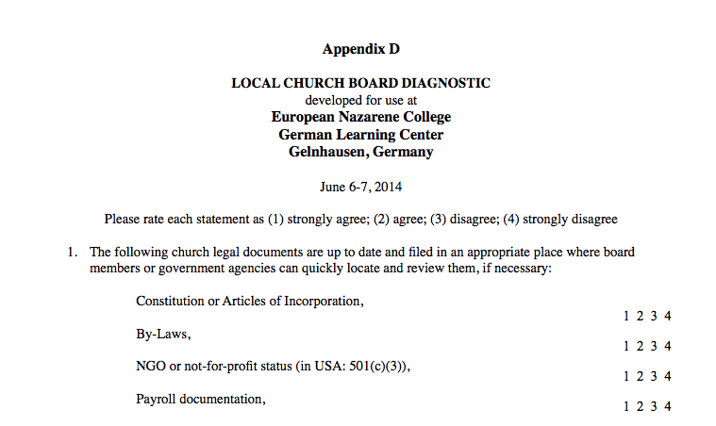
A Local Church Board Diagnostic
SAMPLE LOCAL CHURCH BOARD DIAGNOSTIC
http://www.boardserve.org/writings/
Look for the Local Church Board Diagnostic PDF

Slide 38
1. Understand your mission:
OVERARCHING
MISSION STATEMENT
PLANNING CYCLE
4. Implement your plan:
COMPREHENSIVE
IMPLEMENTATION
PLAN
Continually review
and revise your strategy:
REVIEW AND REVISE
2. Assess your situation:
SITUATION
ASSESSMENT
3. Develop your goals:
PERSONAL/
PROFESSIONAL
GROWTH GOALS

Slide 39
Ministry Connections must be intentional…
From inward to outward focus.
From programs for “us” to people around us.
From ministry in the church building to ministry outside the church.
From a ministry by a few to ministry to the many.
From program development to people development.

Slide 40
TFCN: PLANNING MODEL
Young, bi-lingual,
missionary experienced,
pastor/leader
Healthy Board facilitating congregational growth
TFCN: Mission, Vision, Values and transformative worship
Aggressive outreach to immediate community
Cross-generation,
multi-ethnic, leadership and discipleship training

Slide 41
5
Nurture
emerging leaders
for the church board.
Intentionally!

Slide 42

“Reproduce yourself
as a passionate advocate… for the church and its mission.”

Slide 43
Use committees or “Ministry Teams” as a way to
provide opportunities
for emerging leaders
to take on more responsibility.

Slide 44
A Lay-leadership Paradigm
“Self-Directed Ministry Teams”
Definition: A group of people committed to a specific ministry, or ministry area, that supports the purposes and mission.
      Self Directed – They must own the task.
      Work – Focus on ministry, not maintenance.
      Team – There is more strength in a group.
They need the authority to respond with flexibility to changing events and demands.

Slide 45
Board leaders should
INTENTIONALLY
mentor and nurture
the next generation
of board leadership.

Slide 46
Five "Non-negotiables” for
Local Church Board Health

Slide 47
1. Know the Basics:
2. Ask the ‘Right’ questions:
3. Communicate in conflict situations with civility:
4. Embrace assessment and development in planning:
5. Nurture emerging leaders for the church board:

Slide 48
Both are needed:
STRONG BOARDS who EMPOWER MISSIONAL AND VISIONARY LEADERS;
STRONG LEADERS who EMBRACE PASSIONATE AND ENGAGED BOARDS!

Slide 49

12 CHARACTERISTICS OF
Strong and Effective Boards

Slide 50
Together, we move …
FROM VISION,
TO ACTION,
TO RESULTS!

Slide 51
Summary
Processes to be clarified?
Policies needed?
Questions to be asked?
Plans to be developed?
Projects to be initiated?
Next steps?

Slide 52
Five "Non-negotiables” for
Local Church Board Health
BoardServe.org
www.boardserve.org
lfairbanks@boardserve.org
See also: www.whdl.org/e-lebron-fairbanks
MVNU link: https://mvnu.whdl.org/collections/
dr-e-lebron-fairbanks-collection.
Presentation prepared in conjunction with
World Mission Communication-Asia Pacific
Manila, Philippines
wmc-ap.org

Slide 53
Five "Non-negotiables” for
Local Church Board Health

